Slide 1
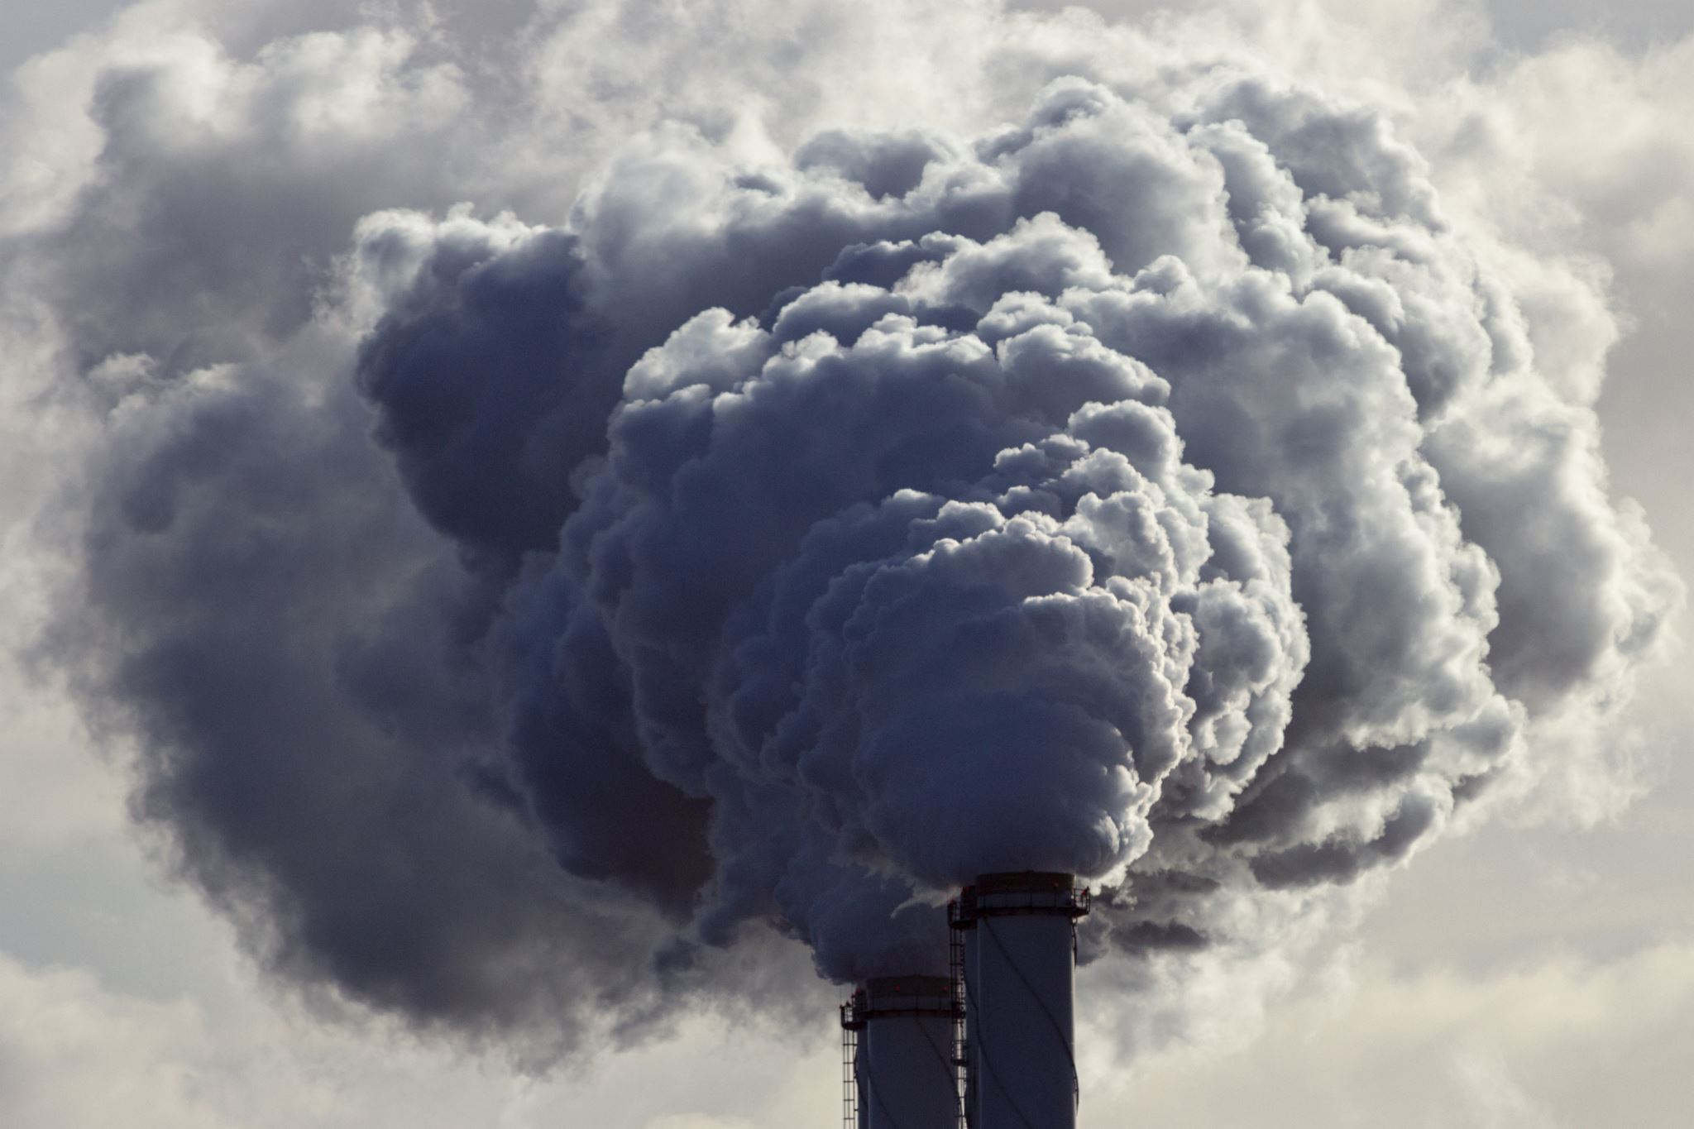
Data source: Air Pollution
The air pollution data is hourly timeseries and was acquired from 2015 to 2024, and for each station in Bristol
Data data reports 14 substances with station name and time

Slide 2

Data source : NHS data
The NHS data is monthly timeseries and contains all NHS trusts in the UK.
The data reports the number of patients based on their emergency type
The patients are also categorized into time they spend on hospital

Slide 3

Data processing and cleaning : approach
The code follows an object-oriented approach and was wrote on anaconda platform and Jupiter notebook in python scripts. This approach enhances reproducibility The coding
steps are as follows:
Importing libraries and initial configurations.
Writing functions for different purposes of ingestion and processing, such as adding a column and removing unacceptable values.
Loading data and merging separate files.
Calling functions and writing code to manage the results of functions and processes.
Saving the results

Slide 4
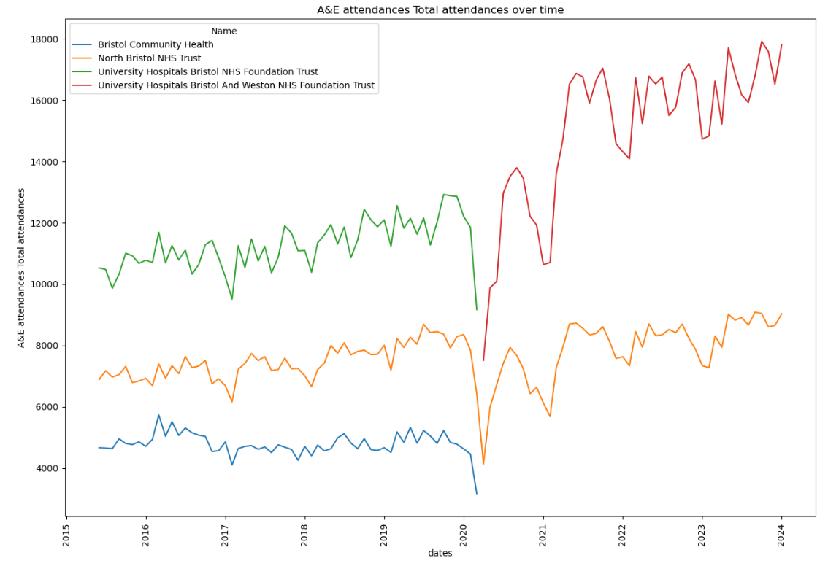
Data processing and cleaning : nhs data
Challenges:
The data is huge and contains 107 months and all hospitals in uk
The dates and name are in files name not a column in each file
Solution:
Sorting and filtering hospitals in Bristol by python
Extracting names and dates and add columns to tables
Merge all the data to one data

Slide 5
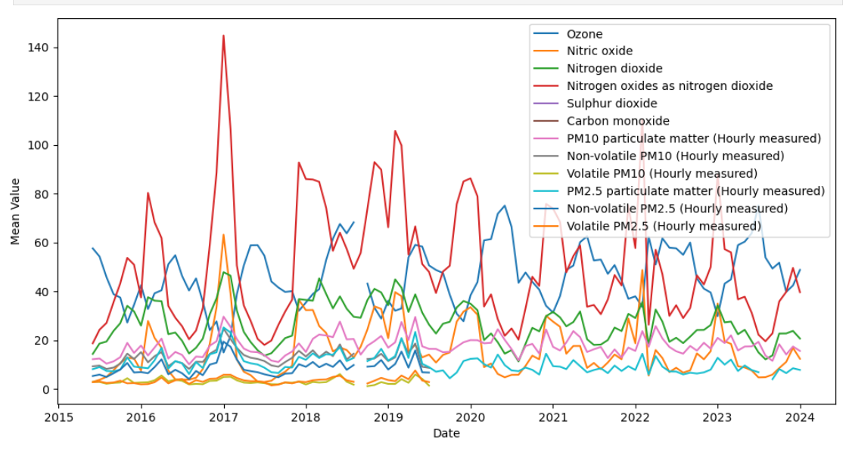
Data processing and cleaning : air pollution data
Challenges :
the air pollution data contains lots of redundant ,'no-data' and negative values.
solution
replace null with unwanted values to null values
convert hourly time series data to monthly data and report min max and mean values

Slide 6

achievements
Achievements
We achieved two data frame of health data and air pollution in the Bristol city which do not have any null or unexpected values

